Slide 1


Slide 2
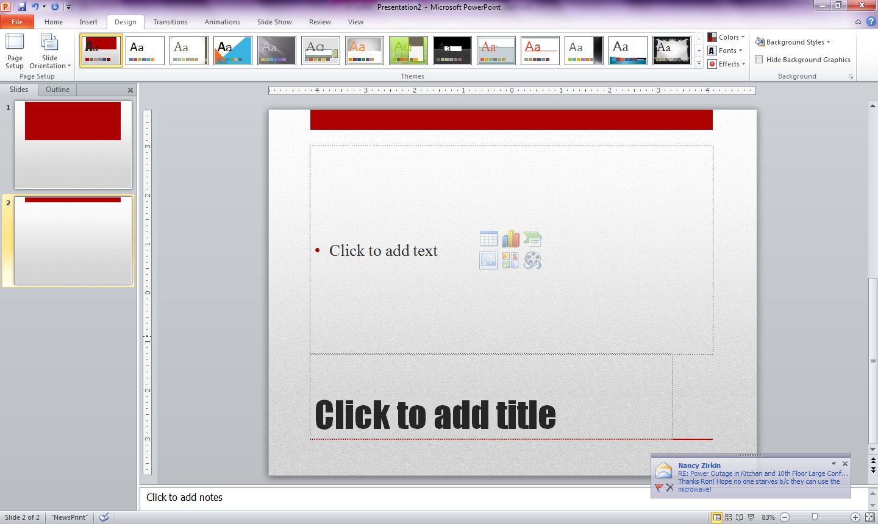
Table of Contents
What is the Voting Rights Act?
What’s the big deal with
Shelby County v. Holder?
Now what? How can we fix this?

Slide 3
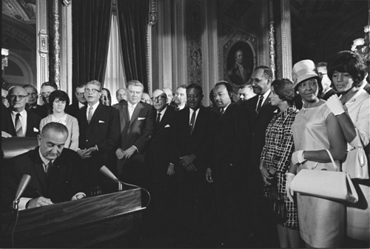
The Voting Rights Act of 1965
Photo: U.S. National Archives.
The right to vote should not be denied on account of race or color.
Notes:
Suggested points to share: The Voting Rights Act (VRA), passed in 1965, is landmark legislation that enforces the 15th Amendment, which says that the right to vote should not be denied on account of race or color. It has been reauthorized by Congress 4 times – with bipartisan support – since it’s passage.

Slide 4
Some of the Key Provisions of the VRA
Enforced the 15th Amendment
Prohibited literacy tests nationwide
Required federal “preclearance” of changes to voting laws or practices in certain jurisdictions

Slide 5
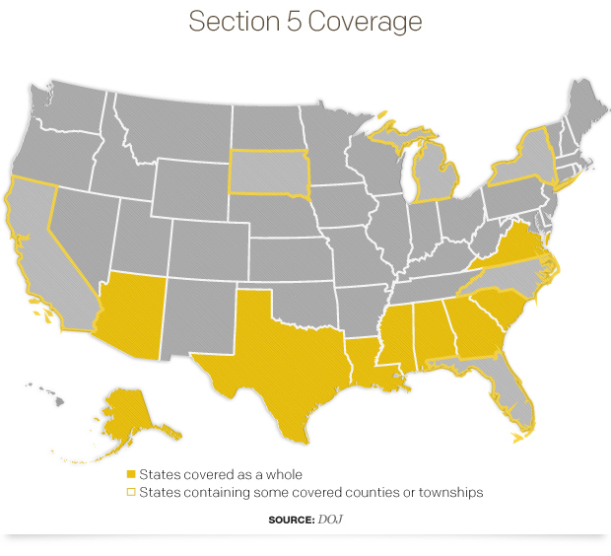
Notes:
Suggested points to share: Section 5 of the VRA requires that the United States Department of Justice, through an administrative procedure, or a three-judge panel of the United States District Court for the District of Columbia, "preclear" any attempt to change “any voting qualification or prerequisite to voting, or standard, practice, or procedure with respect to voting..." in any "covered jurisdiction," which are jurisdictions that fall within the Section 4(b) coverage formula. Until the Court issued its decision in Shelby County v. Holder, Section 5 applied to nine states (Alabama, Alaska, Arizona, Georgia, Louisiana, Mississippi, South Carolina, Texas, and Virginia) and counties or townships in California, Florida, Michigan, New York, North Carolina, and South Dakota.
Section 4(b) of the VRA, contains a formula for determining which jurisdictions will be subject to the preclearance conditions found in Section 5 of the VRA.

Slide 6
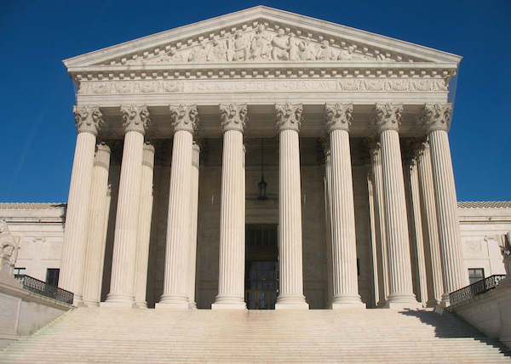
What happened with Shelby County v. Holder?
Photo: www.niemanlab.org

Slide 7
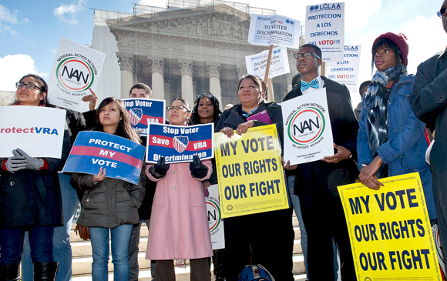
Explanation of Shelby County v. Holder
On June 25, 2013, in a 5-4 decision, the Court struck down Section 4(b) of the VRA, which contains the formula for determining which jurisdictions will be subject to the preclearance.
Photo: www.civilrights.org
The Court invited Congress to act by updating the coverage provision.
Notes:
Suggested points to share: On June 25, 2013, the Supreme Court ruled in Shelby County v. Holder that the coverage formula in Section 4(b) of the Voting Rights Act (VRA), which was used to determine the states and political subdivisions subject to Section 5 preclearance, was unconstitutional. Section 5 is the part of the Voting Rights Act that requires certain jurisdictions to demonstrate to either the Attorney General or a federal court in Washington, D.C., that any proposed voting change is not discriminatory, before that change can be implemented. Thus, while the Court did not invalidate the preclearance mechanism in the Voting Rights Act per se, it effectively halted its use by invalidating the formula that determined which places were subject to the preclearance obligation.

Slide 8
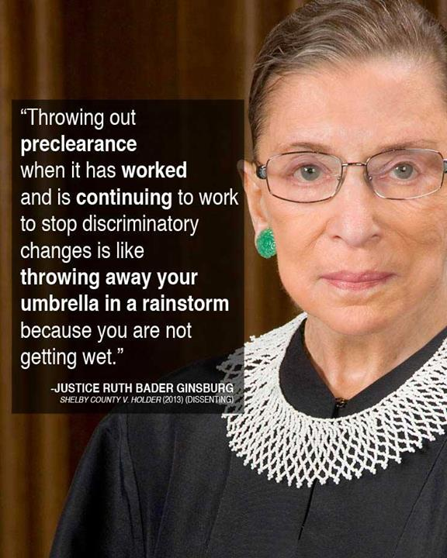
Justice Ginsburg’s Opinion
During oral arguments, Ginsburg argued that under the 15th Amendment, it was Congress' job (not the Court's) to decide when Section 5 of the Voting Rights Act is no longer justifiable.
Photo: www.brennancenter.org
Justice Ruth Bader Ginsburg wrote the dissenting opinion.

Slide 9
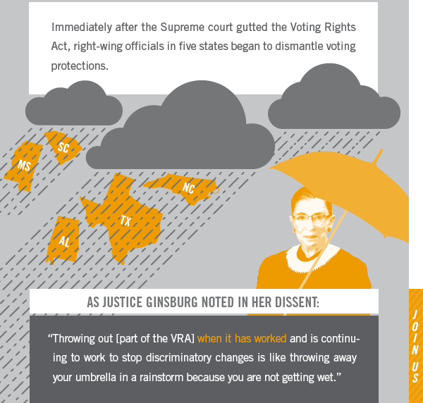
What does the Shelby decision mean
in real time?
Photo: www.freetovote.org

Slide 10
What We Lost in Shelby County v. Holder:
Notice of Voting Changes
Section 5 required covered jurisdictions across the country to report any voting changes they planned to make.
With the Shelby decision, there is now no mechanism for systematically obtaining information about changes to voting procedures for covered jurisdictions.

Slide 11
What We Lost in Shelby County v. Holder:
Preventing Implementation of New Changes
Section 5 prevented voting changes from being implemented until jurisdictions proved that they weren’t racially discriminatory.
With the decision in Shelby County v. Holder, jurisdictions can now implement voting changes without the federal government providing oversight as a check against racial discrimination.

Slide 12
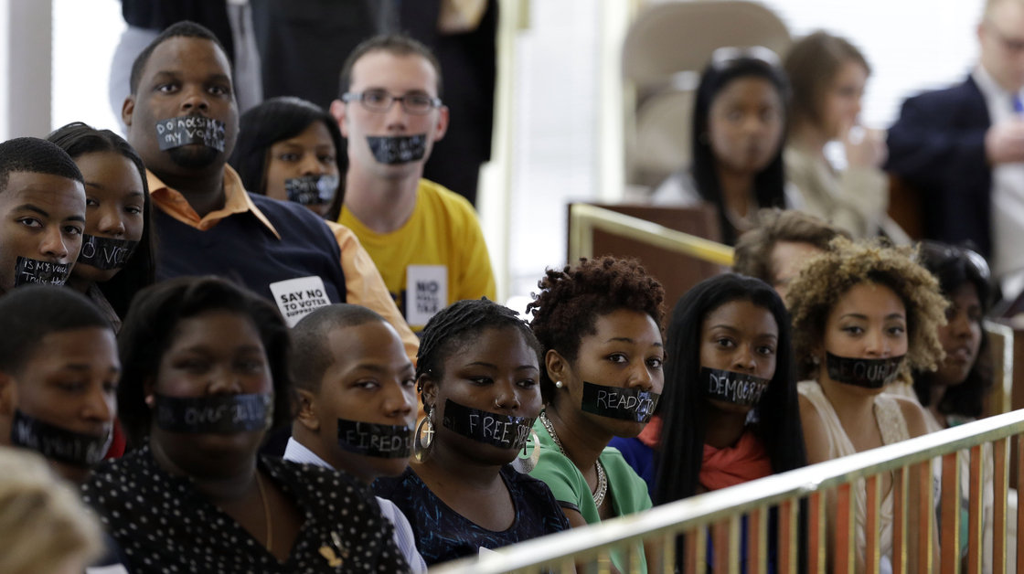
Recent Examples of Section 5 of the Voting Rights Act North Carolina Voter ID (post Shelby)
On April 24, 2013, opponents of North Carolina's new voter ID legislation wear tape over their mouths while sitting in the gallery of the House chamber of the North Carolina General Assembly in Raleigh, N.C., where lawmakers debated new voter laws.
Photo by Gerry Broome/AP
Notes:
Suggested points to share: North Carolina
North Carolina's governor signed a new law requiring a state-approved photo ID to cast a vote in a polling place and shortening the period for early voting. The move came just weeks after the U.S. Supreme Court invalidated a key provision of the Voting Rights Act of 1965, which had required large parts of the state to get federal approval before changing voting laws.
Before the Shelby v. Holder decision, Section 5 of the Voting Rights Act was applied in North Carolina and used as an effective tool to combat discrimination in North Carolina. For over 10 years, Section 5 was used to combat challenges to longer early-voting periods, same-day registration, and preregistration of 17-year-olds. All of that vanished after the Shelby v. Holder decision. The North Carolina Voter ID law reversed crucial reforms designed to help protect the rights of African-Americans, young people and the poor.

Slide 13
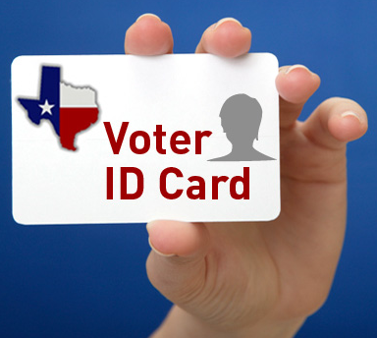
Recent Examples of Section 5 of the Voting Rights Act Texas Voter ID (post Shelby)
Photo: blogs.utexas.edu
Notes:
Suggested points to share: Texas (Voter ID)
In 2012, Section 5 of the Voting Rights Act was used to strike down Texas' ID law, ruling it would potentially disenfranchise hundreds of thousands of minority voters. But that federal decision was invalidated when the Supreme Court ruled part of the Voting Rights Act unconstitutional.
When the Texas Voter ID law passed, 795,000 Texans were registered to vote but did not have a state driver’s license or state-issued ID.
The Texas law allowed people to use a concealed handgun license as a valid form of identification to vote, but did not allow citizens to use a college ID or state employee ID. For example, Victoria Rose Rodriguez, a college student in San Antonio, could have been denied the right to vote because, while she had a student ID, her mother could not afford to put her on her car insurance so she did not have a driver’s license.
Section 5 of the Voting Rights Act – the most effective protection voters had against racial discrimination - was used as an effective tool to combat discrimination and protected the right to vote for African-Americans and Latino voters in Texas.

Slide 14
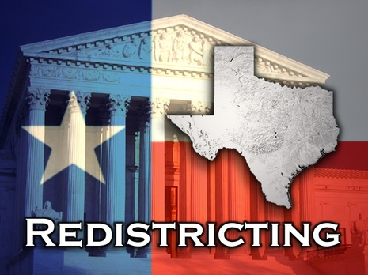
Recent Examples of Section 5 of the Voting Rights Act Texas Redistricting (pre Shelby)
Photo: www.blackradionetwork.com
Notes:
Suggested points to share: Texas (Redistricting)
During the 2011 redistricting, Texas lawmakers attempted to draw political boundaries that discriminated against African-American and Latino voters.
In the past decade, Texas’ population grew by 4.2 million – 89 percent of that growth was minority and 65 percent of that growth was Hispanic. As a result of that overall population growth, Texas gained four new congressional districts. Yet in the 2011 redistricting, not one of the new districts created the ability for the Hispanic or African- American community to elect their candidate of choice.
The federal district court found undisputed evidence that the maps were enacted with the intent to racially discriminate against African-American and Latino voters.
Between January 1, 2012 and the Court’s Shelby decision, Section 5 of the Voting Rights Act, blocked discriminatory redistricting proposals in Texas and were not allowed to be used in the 2012 election cycle.

Slide 15
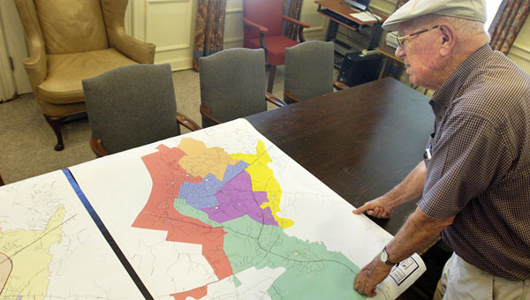
Recent Examples of Section 5 of the Voting Rights Act
Natchez, Mississippi (pre Shelby)
In 2011, the city of Natchez, Mississippi, proposed a redistricting plan that eliminated the ability of Blacks to elect their preferred candidate.
Photo: www.natchezdemocrat.com
Notes:
Suggested points to share: Natchez, Mississippi
In 2011, the city of Natchez, Mississippi, proposed a redistricting plan that reduced the percentage of African-American voters in one ward (Ward 5) by 6 percent and placed these voters into the three wards that were already majority African-American. This change decreased the Black voting-age population in the impacted ward from almost 53 percent to under 47 percent, thus eliminating the ability of Blacks in that ward to elect their preferred candidate.
54 percent of the voting-age population in Natchez is African-American, and the city is governed by a six-member council of aldermen. Opponents said the proposed plan did not account for population shifts reflected in the 2010 Census.
Natchez has a legacy of drawing ward lines to limit African-American voting strength, including another Section 5 objection in 1984. Since 1990, African Americans in Ward 5 have comprised a significant majority of the city’s population, yet the city has continually taken steps to attempt to reduce the Black population share in Ward 5.
During the redistricting process, the city’s redistricting consultant argued that the move of African-American voters out of Ward 5 was necessary to shore up African-American populations in the other wards in order to protect their ability to elect candidates of choice– even though the other wards had significant African-American populations, including one ward with a 97.5 percent African-American voting age population.
Under Section 5 of the Voting Rights Act, the Justice Department concluded that the city’s efforts to reduce the African-American population in Ward 5 were done with a discriminatory purpose. In its letter of objection, DOJ said it appeared that “the city has intentionally and unnecessarily reduced the Black [voting-age population] in Ward 5 under circumstances that suggest the black population in Ward 5 would otherwise have been on the verge of exercising an ability to elect their candidates of choice.”
The redistricting proposal in Natchez, Mississippi is another example of how Section 5 of the Voting Rights Act was used as an effective tool for combatting discrimination.

Slide 16
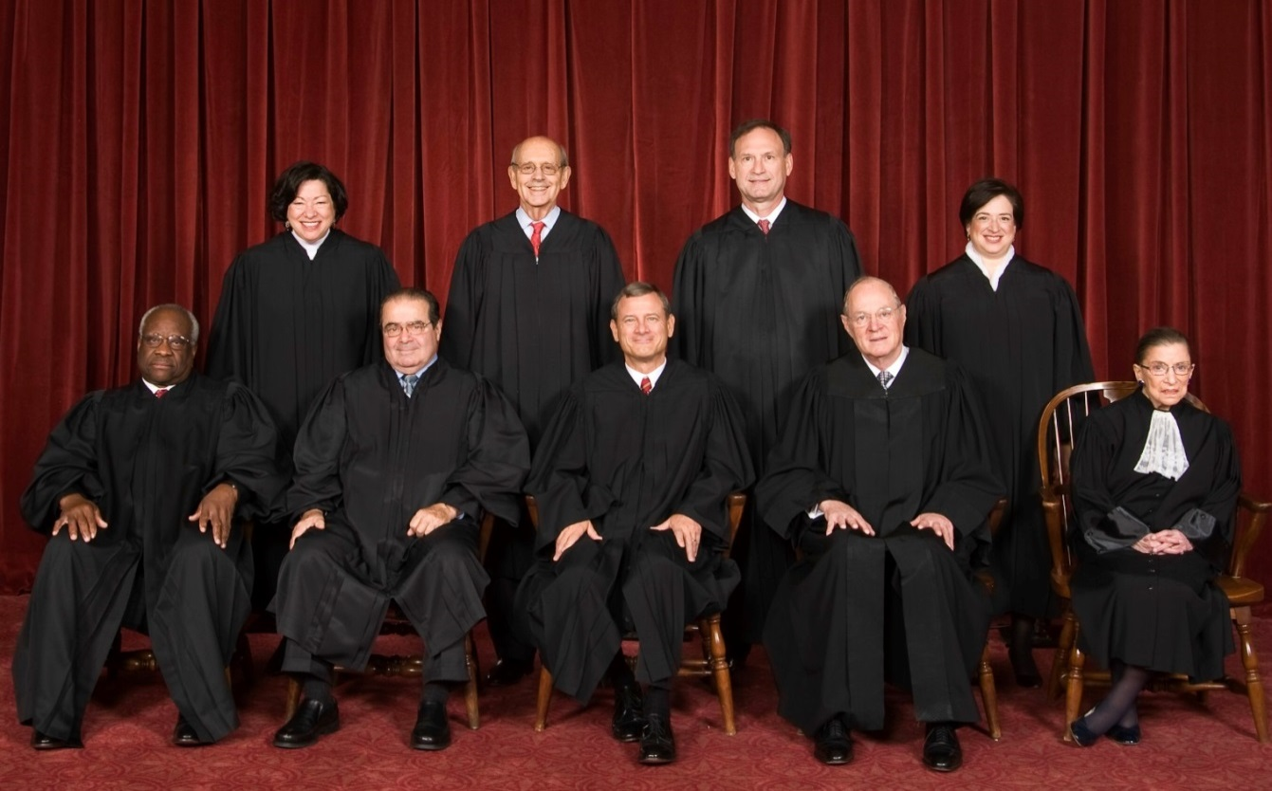
Now what? Is the Court the final word on the VRA?
Photo by Steve Petteway, Collection of the Supreme Court of the United States.

Slide 17
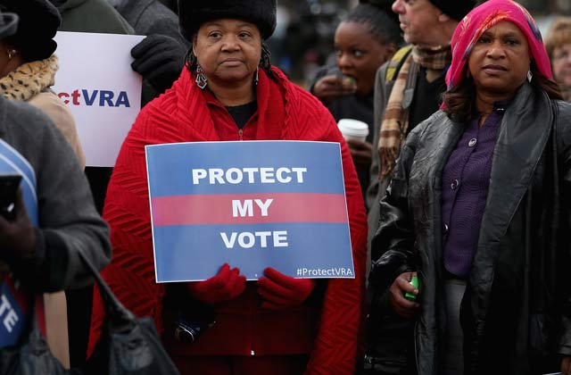
NO!
Photo: www. m.colorlines.com

Slide 18
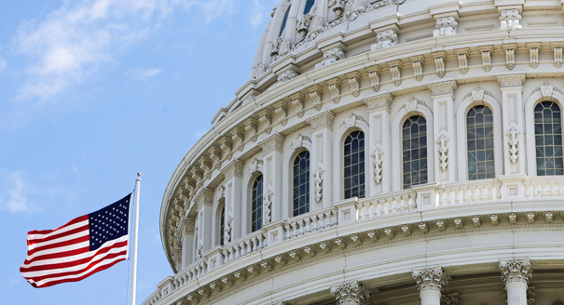
Congress Must Act!
AP Photo

Slide 19
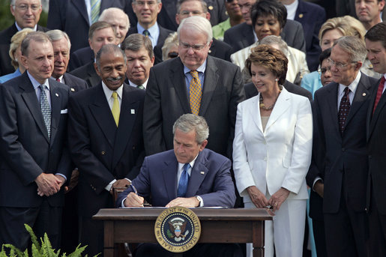
A History of Bipartisan Reauthorizations
1970
1975
1982
White House Photo by Paul Morse
2006
Notes:
Suggested points to share:
Congress has reauthorized the VRA 4 times on a bipartisan basis: 1970, 1975, 1982, 2006

Slide 20

2006 Bipartisan Reauthorization Vote
In 2006, Congress considered:
> 15,000 pages submitted to the record
> 50 witnesses’ testimony from both sides
Congress voted overwhelmingly to pass the reauthorized VRA:
390–33 (House)
98-0 (Senate)
Notes:
Suggested points to share: As recent as 2006, Congress worked together to re-authorize the VRA.

Slide 21

Campaign to Restore the VRA
The clock is ticking!
Now is the moment to organize a campaign to restore the Voting Rights Act.
A Campaign to Educate, Organize and Mobilize.

Slide 22
Campaign to Restore the VRA
Policy, Communications, & Field Activity Timeline
Policy: Legislative strategy
Communications: Communications Strategy to define and develop messages; conducted rapid response
Field: Field activities to push key messages; train grassroots; conduct grassroots lobbying
Jan 20, 2014: Martin Luther King, Jr. Day
Jan 20-24: Congressional Recess
Bill introduction and related activities: field hearings, webinars, trainings, national call, other
January
Feb. 6-Feb7: Voting Rights Conference and Lobby Day
Policy: Legislative strategy to develop language
Communications: Communications Strategy to define and develop messages; conducted rapid response
Field: Field activities to push key messages and train grassroots
Feb 17: President’s Day
Feb 17-21: Congressional Recess
December
February
November
March 2 - March 7: “Bloody Sunday” Anniversary
March 17 – 21: Congressional Recess
March
April
April 14-25: Congressional Recess
May
May 26-30: Congressional Recess
2013
2014
June/July
June 30-July4: Congressional Recess
July 1- July 31: Passage of Legislation
List of Ongoing Activities: Coalition/Taskforce meetings, fundraising, other?
July 2014: Celebrate passage of legislation, prepare for next steps
Notes:
Suggested points to share: Here’s what you can do!
Sign the Petition! www.RestoreVotingRights.org
Fill out the Post Card and sent it to your Member of Congress www.RestoreVotingRights.org
Tweet!
“Join the movement to restore voting rights protections in the U.S. http://restorevotingrights.org/ via @civilrightsorg”
4. Facebook!
Post our featured Restore the Voting Rights Act pic on this slide on your Facebook wall and share it with friends!

Slide 23
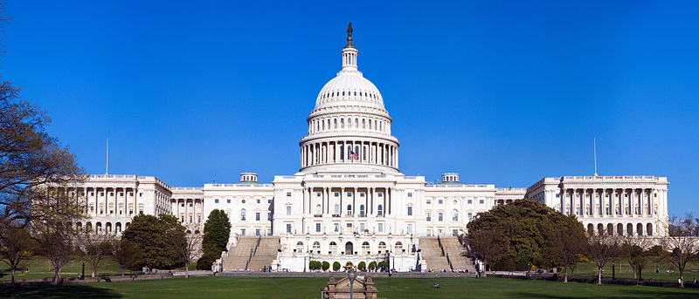
Join the Movement to RestoreVotingRights.org
Photo: www.en.wikipedia.org
Congress is where all the action will take place. Sign the postcard and tell your members of Congress, and U.S. senators, to restore the Voting Rights Act.
Notes:
The URL for the postcard site is https://secure3.convio.net/leader/site/Advocacy?cmd=display&page=UserAction&id=482

Slide 24
Thank You!
The Leadership Conference on Civil and Human Rights
1629 K Street, NW
10th Floor
Washington, DC 20006
www.civilrights.org

